Slide 1
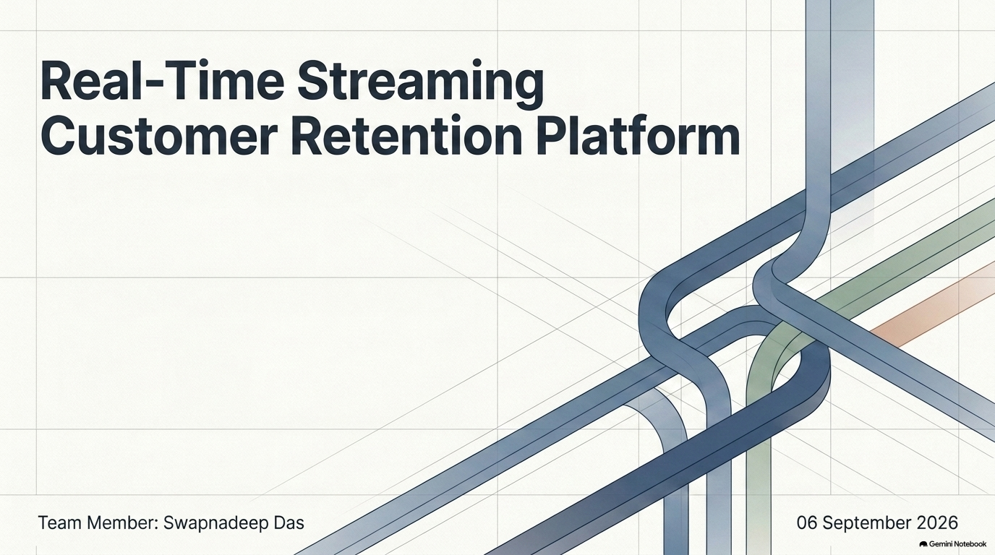

Slide 2
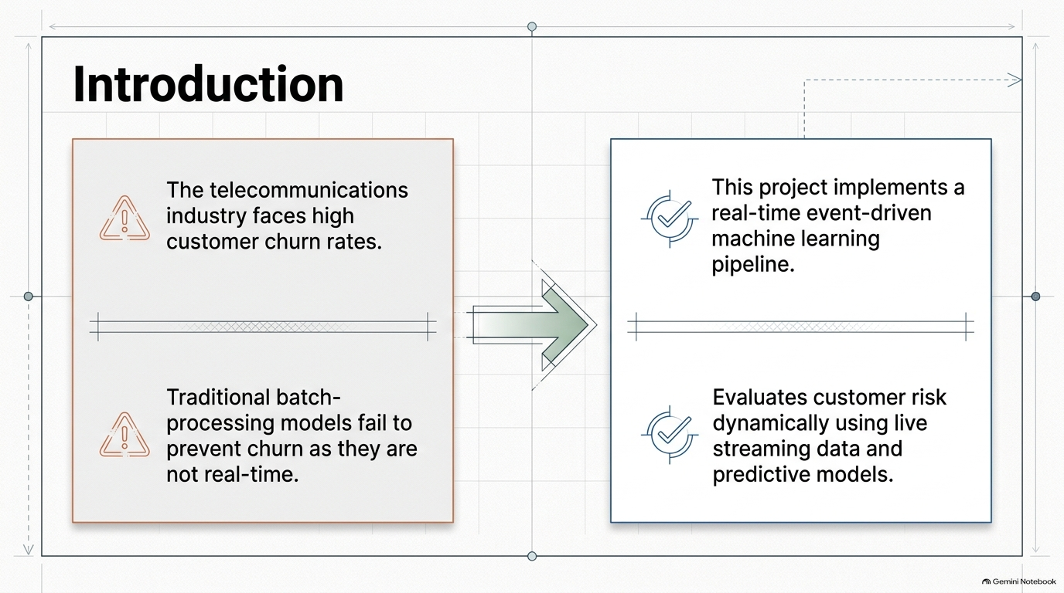

Slide 3
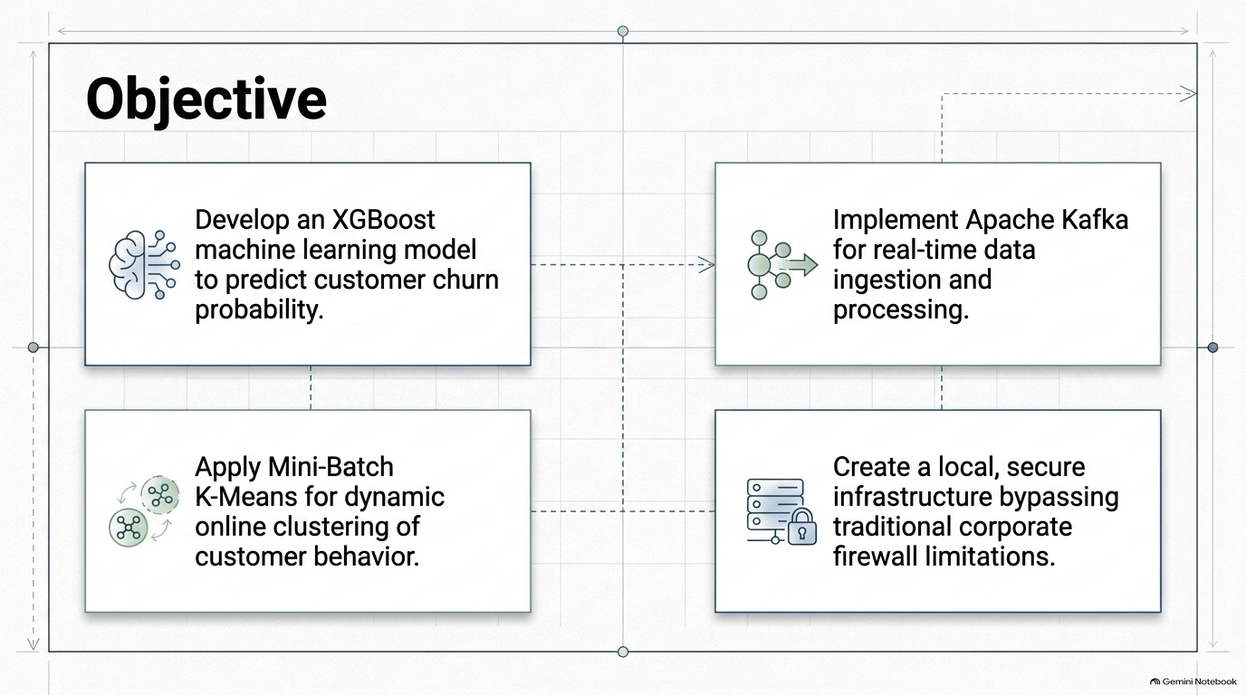

Slide 4
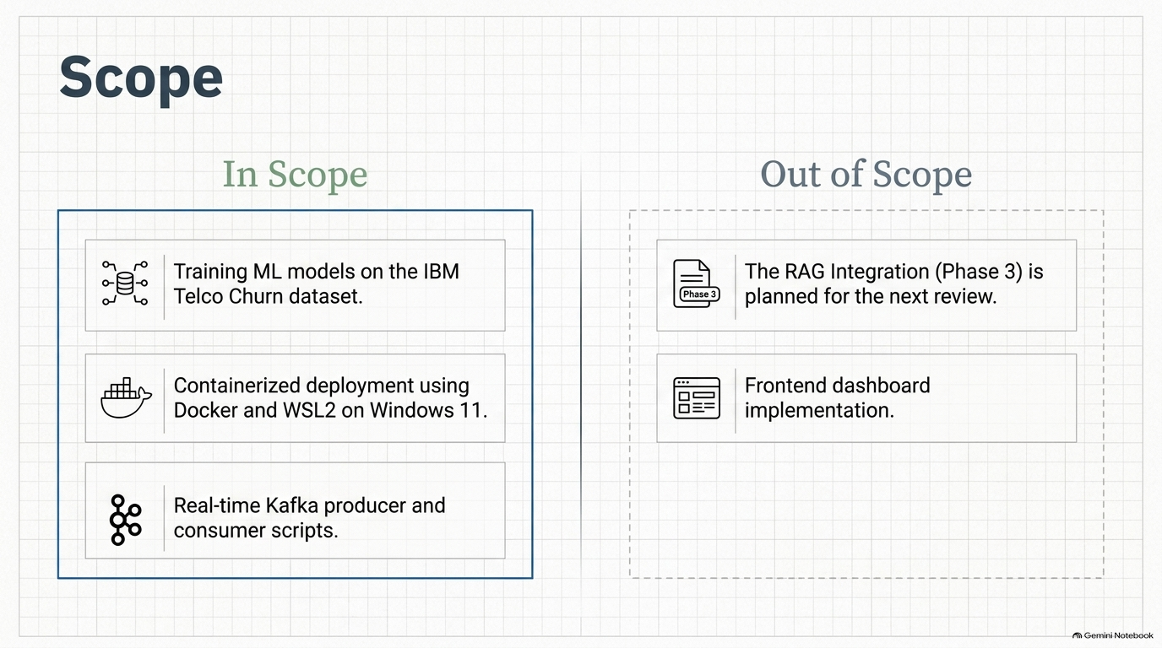

Slide 5
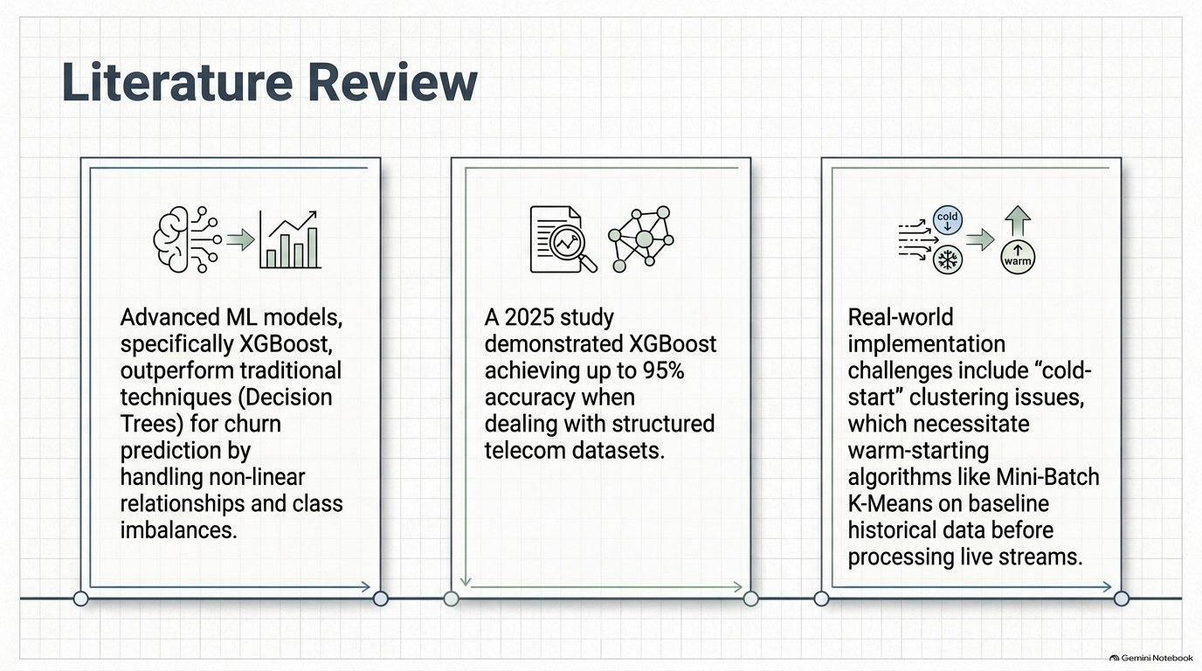

Slide 6
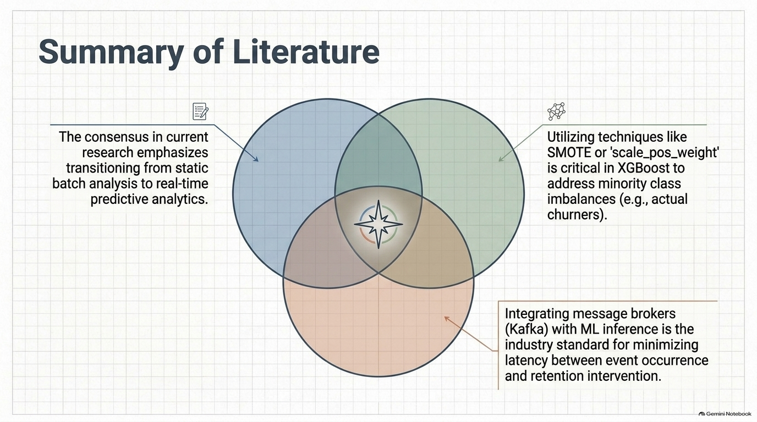

Slide 7
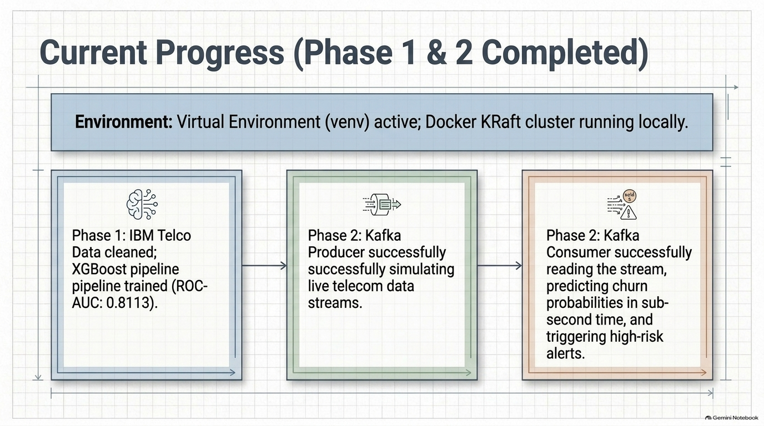

Slide 8
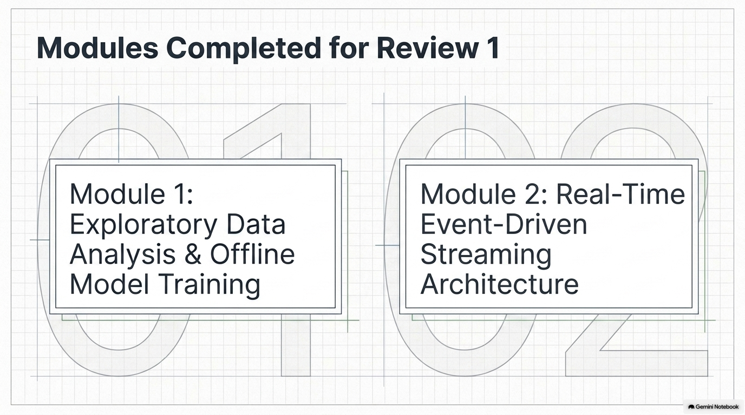

Slide 9
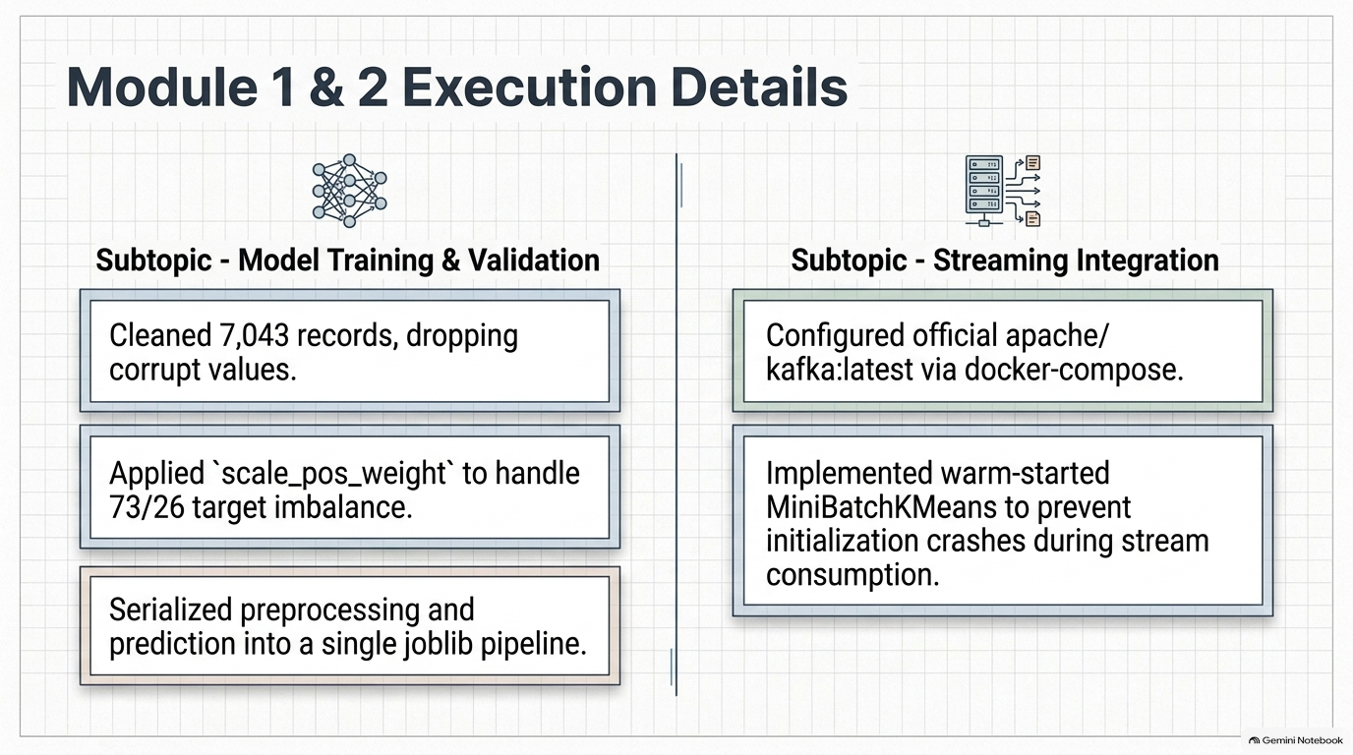

Slide 10
Data Narrator: An Offline Multi-Agent NL-to-SQL Copilot
Swapnadeep Das (M.Tech AI & ML, VIT Vellore)

Slide 11
Introduction
• Business users often lack the technical SQL skills required to extract insights from complex databases.
• Standard text-to-SQL models frequently fail in enterprise environments because they cannot self-correct syntax errors.
• This project introduces a privacy-first, offline multi-agent system that acts as a 'Data Narrator', translating natural language into executable queries.

Slide 12
Objective
• To develop a robust, offline Retrieval-Augmented Generation (RAG) architecture using Large Language Models (LLMs).
• To engineer a multi-agent system that iteratively tests and self-corrects its own code against a live database.
• To ensure 100% data privacy by executing all AI inferences and database transactions locally without cloud APIs.

Slide 13
Scope
• In-Scope (Completed): Setup of isolated Python virtual environments, offline PostgreSQL database, and local LLM (Llama 3.1 8B).
• In-Scope (Completed): Development of a LangGraph conditional routing loop for self-correcting query generation.
• In-Scope (Upcoming - Phase 2): Development of a Streamlit chat interface and natural-language summarization node.
• Out-of-Scope: Real-time event streaming (e.g., Kafka) and cloud-based LLM routing.

Slide 14
Literature Review
• Traditional text-to-SQL approaches rely on 'zero-shot' prompting, yielding low accuracy on complex enterprise schemas.
• Modern research indicates that ReAct (Reasoning and Acting) paradigms significantly improve query accuracy.
• Allowing the AI to view database execution errors enables the system to dynamically debug its own logic.

Slide 15
Summary of Literature
• A linear prompt-to-database pipeline is insufficient for production-grade AI copilots.
• The optimal architecture is a state-driven graph (LangGraph) utilizing a multi-agent loop.
• A 'Coder' agent generates SQL, an 'Executor' tests it, and a conditional edge routes errors back for refinement.

Slide 16

Additional Information (Status Report)
• Development Environment: Fully configured via Windows 11 CMD with Python virtual environment isolation.
• Phase 1 Completion: Northwind-style schema running on PostgreSQL. LangGraph self-correction loop tested and validated.
• Pending IT Approvals: WSL2 and Docker integrations awaiting enterprise IT approval.

Slide 17
Modules to cover
Module 1: Core Infrastructure & State Routing (Completed)
• Database Seeding & Schema Extraction: PostgreSQL installed, schema mapped via LangChain.
• Self-Correcting Agent Loop: LangGraph architecture deployed for automated SQL debugging.
Module 2: Presentation & Summarization (Upcoming Phase 2)
• Natural Language Generation: Translating raw SQL tuples back into conversational English.
• Streamlit UI Dashboard: Building the frontend chat interface.

